Slide 1
Instructor Materials Chapter 8: Joining the Order of Cybersecurity Specialist
Cybersecurity Essentials v1.0
Notes:
Cisco Networking Academy Program
Cybersecurity Essentials
Chapter 8: Joining the Order of Cybersecurity Specialist

Slide 2
Instructor Materials - Chapter 8 Planning Guide
This PowerPoint deck is divided in two parts:
Instructor Planning Guide
Information to help you become familiar with the chapter
Teaching aids
Instructor Class Presentation
Optional slides that you can use in the classroom
Begins on slide #10
Note: Remove the Planning Guide from this presentation before sharing with anyone.
Notes:
2

Slide 3
Cybersecurity Essentials v1.0
Planning Guide
Chapter 8: Joining the Order of Cybersecurity Specialist
Notes:
Cybersecurity Essentials v1.0 Planning Guide
Chapter 8: Joining the Order of Cybersecurity Specialist

Slide 4
Chapter 8: Activities
What activities are associated with this chapter?
The password used in the Packet Tracer activities in this chapter is: PT_cyber1
Page Number | Activity Type | Activity Name
8.1.7.3 | IA | Matching Cybersecurity Domains
8.2.1.3 | IA | Exploring Cyber Ethics
8.2.2.7 | IA | Matching Cybersecurity-related Laws
8.2.4.5 | IA | Using the Appropriate Tool
8.3.1.3 | Packet Tracer | Skills Integrated Challenge
Notes:
4

Slide 5
Chapter 8: Assessment
Students should complete Chapter 8, “Assessment” after completing Chapter 8.
Quizzes, labs, Packet Tracers and other activities can be used to informally assess student progress.
Notes:
5

Slide 6
Chapter 8: Best Practices
Prior to teaching Chapter 8, the instructor should:
Complete Chapter 8, “Assessment.”
The concepts and topics covered here will follow the students through their cybersecurity career. Make sure to take your time to eliminate any misconceptions.
This chapter introduces the three dimensions of the cybersecurity in the form of a sorcery cube. Emphasize how each of the three dimensions contributes to overall security.
The chapter also introduces the ISO cybersecurity model. The model represents an international framework to standardize the management of information systems. Describe each of the twelve domains.
Notes:
6

Slide 7
Chapter 8: Best Practices (Cont.)
Encourage students to explore each of the major topics in this chapter.
Cybersecurity Membership | URL Address
ISC2 Code of Ethics | https://www.isc2.org/uploadedfiles/(isc)2_public_content/code_of_ethics/isc2-code-of-ethics.pdf
Cybersecurity Careers | https://niccs.us-cert.gov/careers/cybersecurity-careers
Careers in Cybersecurity- Expert Advice From BlackHat & DEFCON | https://www.youtube.com/watch?v=EhIp3b8iGm4
Cyber Security Jobs | https://www.youtube.com/watch?v=WIwCUL5Vex0
Cybersecurity Careers | https://www.youtube.com/watch?v=zEIHY_R2Zug
Notes:
7

Slide 8
Chapter 8: Additional Help
For additional help with teaching strategies, including lesson plans, analogies for difficult concepts, and discussion topics, visit the Cybersecurity Essentials Community at community.netacad.net.
If you have lesson plans or resources that you would like to share, upload them to the Cybersecurity Essentials Community in order to help other instructors.
Notes:
8

Slide 9
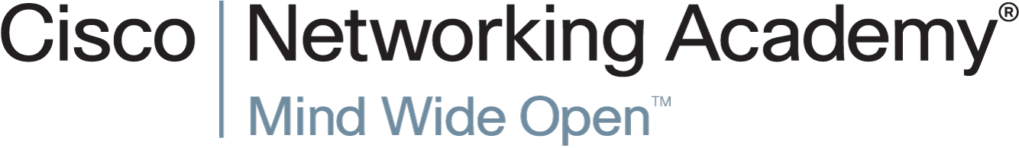

Slide 10
Chapter 8: Joining the Order of Cybersecurity Specialist
Cybersecurity Essentials v1.0
Notes:
Cisco Networking Academy Program
Cybersecurity Essentials v1.0
Chapter 8: Joining the Order of Cybersecurity Specialist

Slide 11
Chapter 8 - Sections & Objectives
8.1 Cybersecurity Domains
Describe resources available to students interested in pursuing a career in cybersecurity.
8.2 Understanding the Oath of Membership
Explain how ethics provide guidance.
8.3 Next Step
Explain how to take the next step to become a cybersecurity professional.
Notes:
11

Slide 12
8.1 Cybersecurity Domains
Notes:
Cisco Networking Academy Program
Cybersecurity Essentials
Chapter 8: Joining the Order of Cybersecurity Specialist

Slide 13
Cybersecurity Domains User Domain
Common User Threats and Vulnerabilities
The User Domain includes the users who access the organization’s information system.
Users can be employees, customers, business contractors and other individuals that need access to data.
Users are often the weakest link in the information security systems and pose a significant threat to the confidentiality, integrity, and availability of the organization’s data.
Managing User Threats
Conduct security awareness training and user education.
Enable and automate content filtering and antivirus scanning.
Disable internal CD drives and USB ports.
Minimize permissions, restrict access, track and monitor users and enable intrusion detection.

Slide 14
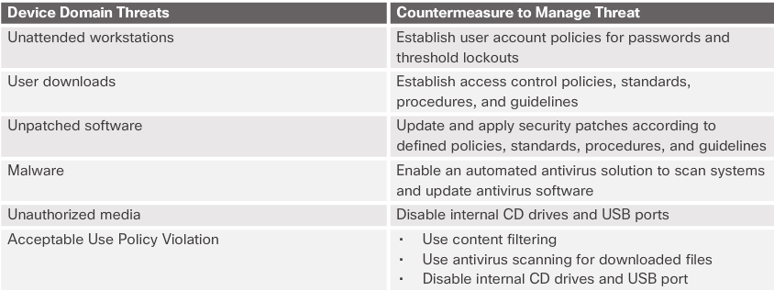
Cybersecurity Domains Device Domain
Common Threats to Devices
Unattended workstations, user downloads, unpatched software
Malware, use of unauthorized media, and violations of the acceptable use policy.

Slide 15
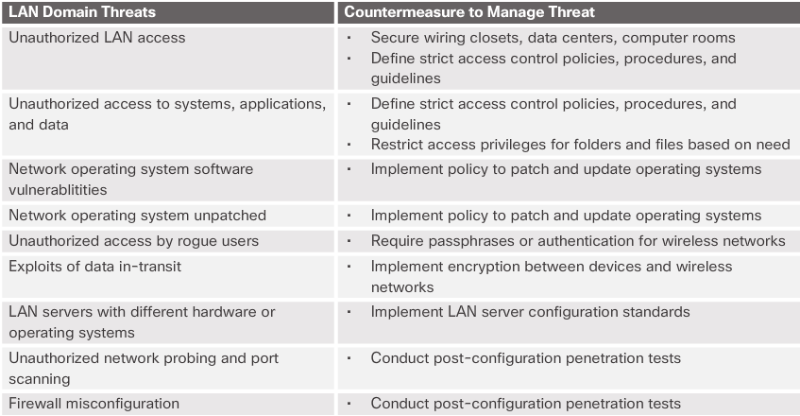
Cybersecurity Domains Local Area Network Domain
Common Threats to the LAN
Unauthorized LAN access, unauthorized access to systems, applications, wireless networks and data
Network operating system software vulnerabilities, misconfigurations and failure to perform updates
Unauthorized network probing and port scanning

Slide 16
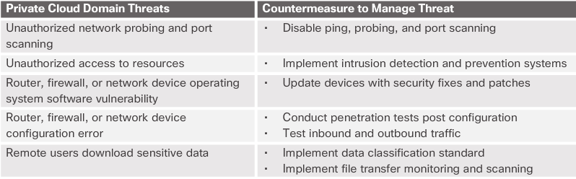
Cybersecurity Domains Private Cloud (WAN) Domain
Common Threats to the Private Cloud:
Unauthorized network probing, port scanning and access to resources.
Router, firewall, or network device operating system software vulnerability and misconfiguration.
Remote users accessing the organization’s infrastructure and downloading sensitive data.

Slide 17
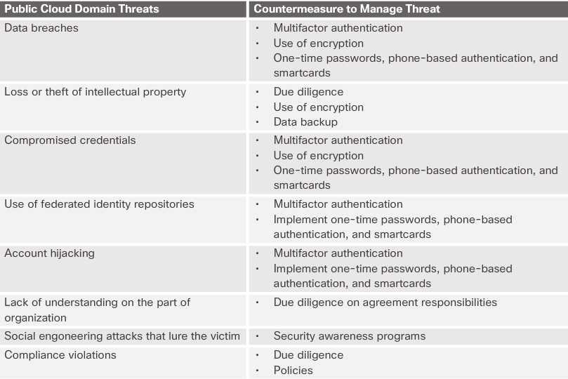
Cybersecurity Domains Public Cloud Domain
Common Threats to the Public Cloud:
Data breaches, loss or theft of intellectual property and compromised credentials.
Federated identity repositories are a high-value target.
Account hijacking, social engineering attacks and lack of understanding on the part of the organization.

Slide 18
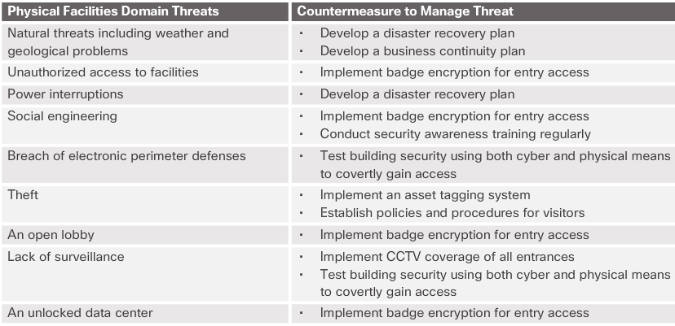
Cybersecurity Domains Physical Facilities Domain
Common Threats to Physical Facilities:
Natural threats including weather problems, geological hazards, and power interruptions
Unauthorized access to the facilities, open lobbies, theft, unlocked data center, lack of surveillance
Social engineering, breach of electronic perimeter defenses

Slide 19
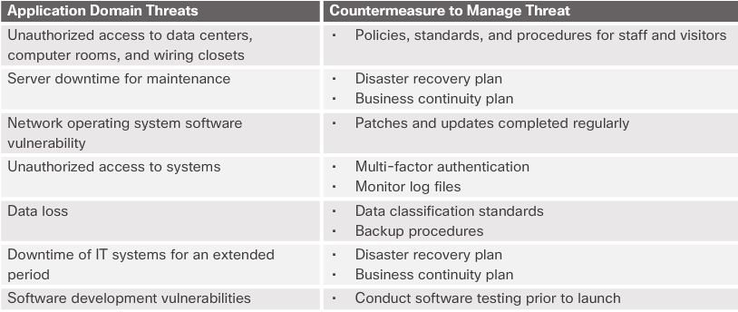
Cybersecurity Domains Application Domain
Common Threats to Applications:
Unauthorized access to data centers, computer rooms, and wiring closets
Server downtime for maintenance, IT systems down for extended periods
Network operating system software vulnerability
Unauthorized access to systems
Data loss

Slide 20
8.2 Understanding the Oath of Membership
Notes:
Cisco Networking Academy Program
Cybersecurity Essentials
Chapter 8: Joining the Order of Cybersecurity Specialist

Slide 21
Understanding the Oath of Membership Ethics and Guiding Principles
Ethics of a Cybersecurity Specialist
Ethics is the little voice in the background guiding a cybersecurity specialist as to what he should or should not do, regardless of whether it is legal. The organization entrusts the cybersecurity specialist with the most sensitive data and resources. The cybersecurity specialist needs to understand how the law and the organization’s interests help to guide ethical decisions.
Computer Ethics Institute
The Computer Ethics Institute is a resource for identifying, assessing, and responding to ethical issues throughout the information technology industry. CEI was one of the first organizations to recognize the ethical and public policy issues arising from the rapid growth of the information technology field.

Slide 22
Understanding the Oath of Membership Cyber Laws and Liability
Cybercrime
Laws prohibit undesired behaviors. Unfortunately, the advancements in information system technologies are much faster than the legal system can accomodate. A number of laws and regulations affect cyberspace.
Cybercrime
A computer may be involved in a cybercrime in a couple of different ways. There is computer-assisted crime, computer-targeted crime, and computer-incidental crime. Child pornography is an example of computer-incidental crime; the computer is a storage device and is not the actual tool used to commit the crime.
Organizations Created to Fight Cybercrime
There are a number of agencies and organizations out there to aid the fight against cybercrime.

Slide 23
Understanding the Oath of Membership Cyber Laws and Liability (Cont.)
Civil, Criminal, and Regulatory Cyber Laws
In the United States, there are three primary sources of laws and regulations: statutory law, administrative law, and common law. All three sources involve computer security. The U.S. Congress established federal administrative agencies and a regulatory framework that includes both civil and criminal penalties for failing to follow the rules.
Industry Specific Laws
Gramm-Leach-Bliley Act (GLBA)
Sarbanes-Oxley Act (SOX)
Payment Card Industry Data Security Standard (PCI DSS)
Import/Export Encryption Restrictions
Security Breach Notification Laws
Electronic Communications Privacy Act (ECPA)
Computer Fraud and Abuse Act (1986)

Slide 24
Understanding the Oath of Membership Cyber Laws and Liability (Cont.)
Protecting Privacy
Privacy Act of 1974
Freedom of Information ACT (FOIA)
Family Education Records and Privacy Act (FERPA)
U.S. Computer Fraud and Abuse Act (CFAA)
U.S. Children’s Online Privacy Protection Act (COPPA)
U.S. Children’s Internet Protection Act (CIPA)
Video Privacy Protection Act (VPPA)
Health Insurance Portability & Accountability Act
California Senate Bill 1386 (SB 1386)
International Laws
Convention on Cybercrime
Electronic Privacy Information Center (EPIC)

Slide 25
Understanding the Oath of Membership Cybersecurity Information Websites
National Vulnerability Database (NVD) - is a U.S. government repository of standards-based vulnerability management data that uses the Security Content Automation Protocol (SCAP).
CERT - The Software Engineering Institute (SEI) at Carnegie Mellon University helps government and industry organizations to develop, operate, and maintain software systems that are innovative, affordable, and trustworthy. It is a Federally Funded Research and Development Center sponsored by the U.S. Department of Defense.
Internet Storm Center - provides a free analysis and warning service to Internet users and organizations. It also works with Internet Service Providers to combat malicious cyber criminals. The Internet Storm Center gathers millions of log entries from intrusion detection systems every day using sensors covering 500,000 IP addresses in over 50 countries.
The Advanced Cyber Security Center (ACSC) - is a non-profit organization that brings together industry, academia, and government to address advanced cyber threats. The organization shares information on cyber threats, engages in cybersecurity research and development, and creates education programs to promote the cybersecurity profession.

Slide 26
Understanding the Oath of Membership Cybersecurity Weapons
Vulnerability Scanners - assess computers, computer systems, networks, or applications for weaknesses. Vulnerability scanners help to automate security auditing by scanning the network for security risks and producing a prioritized list to address weaknesses.
Penetrating Testing (or pen testing) - is a method of testing the areas of weaknesses in systems by using various malicious techniques. Pen testing is not the same as vulnerability testing. Vulnerability testing just identifies potential problems. Pen testing involves a cybersecurity specialist who hacks a website, network, or server with the organization’s permission to try to gain access to resources without the knowledge of usernames, passwords, or other normal means.
Packet Analyzers (or packet sniffers) - intercept and log network traffic. The packet analyzer captures each packet, shows the values of various fields in the packet, and analyzes its content. A sniffer can capture network traffic on both wired and wireless networks.
Security Tools - There is no one size fits all when it comes to the best security tools. Much depends on the situation, circumstance, and personal preference. A cybersecurity specialist must know where to go to get sound information.
Notes:
1.2 – Cybercriminal versus Cyber Heroes
1.2.2 – Cyber Criminal Motives

Slide 27
8.3 Next Step
Notes:
Cisco Networking Academy Program
Cybersecurity Essentials
Chapter 8: Joining the Order of Cybersecurity Specialist

Slide 28
Next Step Exploring the Cybersecurity Profession
Defining the Roles of Cybersecurity Wizards
The ISO standard defines the role of cybersecurity wizards. The ISO 27000 framework requires:
A senior manager responsible for IT and ISM (often the audit sponsor)
Information security professionals and security administrators
Site/physical security manager and facilities contacts
HR contact for HR matters such as disciplinary action and training
Systems and network managers, security architects and other IT professionals
Job Search Tools
A variety of websites and mobile applications advertise information technology jobs. Each site targets varying job applicants and provides different tools for candidates researching their ideal job position:
Indeed.com
CareerBuilder.com
USAJobs.gov

Slide 29
8.4 Chapter Summary
Notes:
Cisco Networking Academy Program
Cybersecurity Essentials
Chapter 8: Joining the Order of Cybersecurity Specialist

Slide 30
Chapter Summary Summary
This chapter categorizes the information technology infrastructure created by the advancement of technology into seven domains.
The chapter discussed the laws that affect technology and cybersecurity requirements.
Laws such as FISMA, GLBA, and FERPA focus on protecting confidentiality.
Laws that focus on the protection of integrity include FISMA, SOX, and FERPA, and laws that concern availability include FISMA, GLBA, SOX, and CIPA.
In addition to the laws in force, the cybersecurity specialist needs to understand how the use of computers and technology affect both individuals and society.
The chapter also explored the opportunity to become a cybersecurity specialist.
Finally, this chapter discussed several tools available to cybersecurity specialists.

Slide 32


